Slide 1

MEDA
^{welcome to}
^{ORIENTATION}
+

Slide 2

^{INTRODUCTIONS}
What is your name?
If you had $1 million, what would you do with it?
^{Introduction}
^{MEDA}
+
Notes:
Now that I have talked about us, it is your turn to talk a little about yourself.

Slide 3

^{MEDA’S MISSION}
MEDA’s mission is to strengthen low- and moderate-income Latino families by promoting economic equity and social justice through asset building and community development
^{Your journey}
^{MEDA}

Slide 4
^{WHAT WE ARE HOPING TO ACHIEVE}
Families are financially thriving
Families have affordable and stable housing
Children and youth succeed in school
San Francisco Latinos are decision-makers in the institutions and political systems that affect their lives
The Mission District is a strong & supportive community for Latino residents, their businesses and institutions
^{Your journey}
^{MEDA}

Slide 5
^{OUR PHILOSOPHY}
Financial Capability will make or break your life goals!
Financial power is political power!
Asset Building is imperative for our community, now MORE THAN EVER!
That’s why Financial Capability is central in all MEDA programs!
^{Your journey}
^{MEDA}

Slide 6
Everyone, regardless of income, immigration status or education, can reach their goals.
^{Your journey}
^{MEDA}
Notes:
EVERYONE REGARDLESS OF INCOME, EDUCATION, IMMIGRATION STATUS CAN ACHIEVE THIS
small steps are big steps!! i.e self-sufficiency measures- achieving certain income level vs. building budgets, etc…
^{Why bother?}
Work with what you have already and build off that- just get started!!! Everyone has their own path and circumstance ^{No right or wrong} MEDA as trusted/credible source Note that people are used to being turned down

Slide 7
$500 Emergency Savings
700+ Credit Score
Rental / Mortgage Ready
Safe
Banking
What does it mean to be Financially Thriving?
ITIN’s
Tax Credits
Public Benefits
Safe
Banking
Career Pathways
Tax Credits
Tax
Credits
^{Your journey}
^{MEDA}
Notes:
We can talk more about this when we talk about the programs we have to offer and the financial education piece of the workshop.

Slide 8




^{YOUR FUTURE}
What do you want for your future?
How does it feel
to be there?
What values do you strive for?
5 min
^{Your future}
^{MEDA}
+
Notes:
Page 1 of “Start Your Journey” handout

Slide 9



^{YOUR SITUATION TODAY}
Where are you today?
How does it
feel?
How are you working towards your future?
5 min
^{Your situation today}
^{MEDA}
+
Notes:
Page 2 of “Start Your Journey” handout

Slide 10

MPN
(Mission Promise Neighborhood)
POLICY
MEDA
CRE
(Community Real Estate)
DIRECT SERVICES

Slide 11

YOUR JOURNEY:
MEDA can help!
MEDA
5
1
1. Financial Assets Program
2. Workforce Development
3. Housing Opportunities
4. Business Development
5. Adelante Fund
4
2
3
^{MEDA}
^{The journey}
^{MEDA}
+

Slide 12
1
Financial Assets Program
MEDA
5
1
Free year-round tax return preparation
ITIN applications
Access public benefits
Access financial products
Reach your financial goal
4
2
3
^{MEDA}
^{The journey}
^{MEDA}
^{The journey}
+

Slide 13
2
Workforce
Development
MEDA
5
1
Help you with resume applications, networking, and referrals
Skills training and job placement:
Mission Techies
4
2
3
^{The journey}
^{MEDA}
^{The journey}
+

Slide 14
3
Housing
Opportunities
MEDA
5
1
Rental preparedness: find affordable rents in SF.
First time home-buyers: learn how to buy a home in the SF Bay Area ($50 fee)
4
2
3
^{The journey}
^{MEDA}
^{The journey}
+

Slide 15
4
Business
Development
MEDA
5
1
Business workshops: training, business plan and certificate…in 6 weeks
One-on-one consultations to help you develop your own business step by step
Assistance to formalize your business
Commercial lease negotiation assistance
4
2
3
^{The journey}
^{MEDA}
^{The journey}
+

Slide 16
5
Adelante
Fund
MEDA
5
1
Micro lending program for small business owners:
Apply for $5,000-100,000 loan at 7-9% interest rate
Most important approval criteria: proven capacity to make the monthly loan payment
No cost to apply and ITIN holders are encouraged to apply
4
2
3
^{The journey}
^{MEDA}
^{The journey}
+

Slide 17
Housing Opportunities
MEDA
5
1
Rental opportunities:
BMR rental application:
Apply
Identify your preference
Check for lottery results
Obtain the apartment
Keep applying
4
2
3
^{The journey}
^{MEDA}
^{The journey}
+

Slide 18
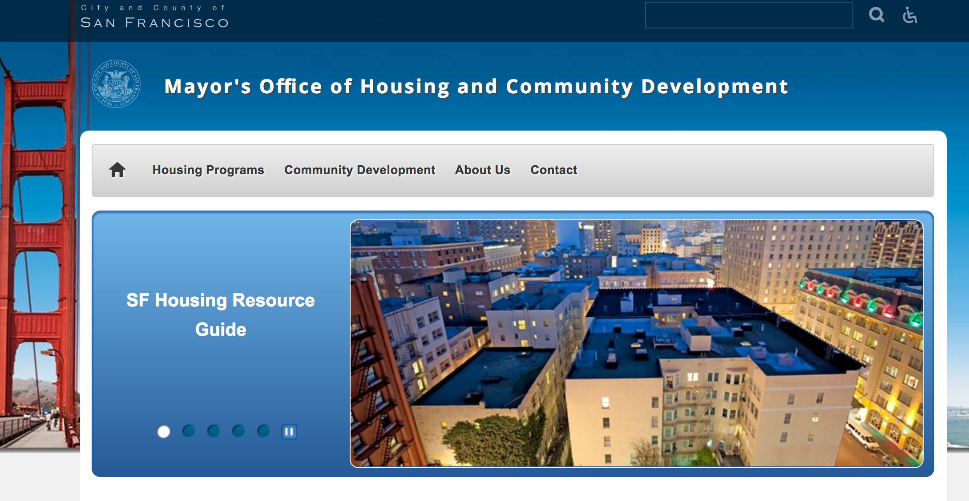
Where is the Information to Apply for Affordable Housing?

Slide 19
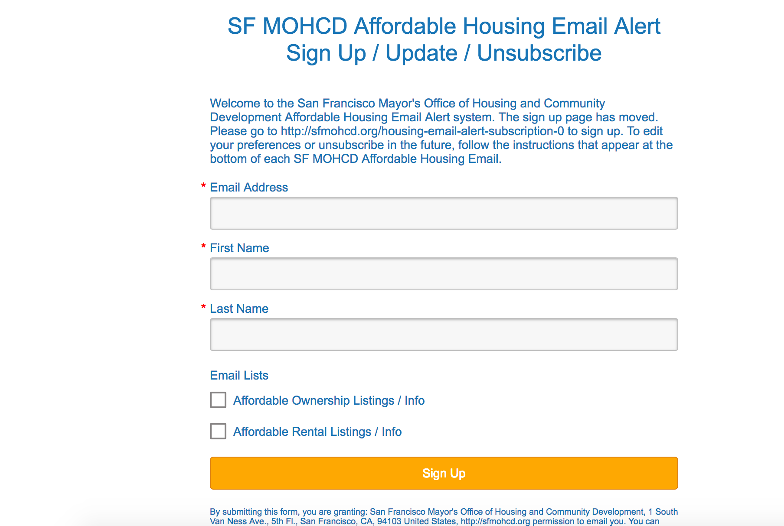
First Step: Register to Get Emails

Slide 20
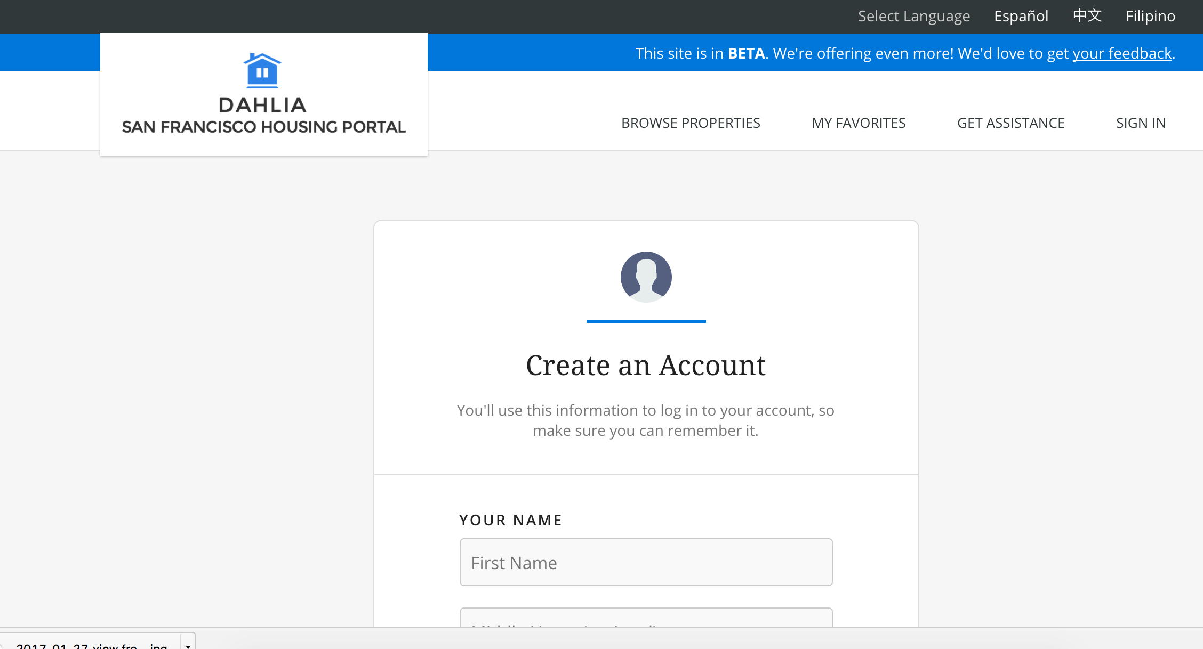
Applying Online is Best!
If you have an email address, open your account on DAHLIA
-Full name
-Date of birth
-Password
How to apply: como aplicar
Get a paper application: obtenga su aplicación en la oficina o la puede bajar del Internet -Download application-
Submit a Paper application: Entregarla en la oficina o enviarla por correo antes del plazo
Notes:
What type of buildings are being built in Mission and for whom?

Slide 21
BMR Rental Lottery Preferences
There are multiple types of preferences based on developer, property management and MOHCD. But the three listed are the most frequent categories:
Live/Work In San Francisco: This preference is given to all applicants who attach a document to their application that verifies they live or work in San Francisco. Applicants must choose from a list of documents to be eligible.
Displaced Tenant Housing Preference (DTHP): This preference is given to applicants who have been evicted through Ellis Act (Owner Move In) or have been victim to a residential fire in their home
Certificate of Preference (COP): Certificate of preference was given to folks who were displaced in the 1970s from HUD redevelopment actions in the Fillmore District
dljkl
Notes:
Anyone can apply to the Below Market Rate apartments on Dahlia Portal, created by the Mayor’s Office of Housing and Community Development. Some applicants however will be eligible for preferences which may give them a higher ranking in the lottery. It is important for folks moving forward to understand the preference categories to assess if they are eligible! At the time of applying on Dahlia, it is as easy as uploading a picture or checking a box!
To be clear, there are multiple types of preferences based on developer, property management and MOHCD. But the three listed above are the most frequent categories.

Slide 22
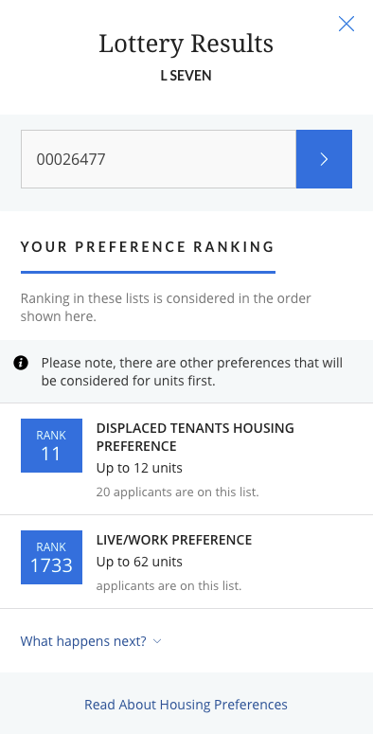
Lottery Results
Notes:
Youth will be directly referred by the agencies and there are subsidies for those earning less than 14k annually.
Remember the rent of a 2 bedroom apartment in the mission currently.

Slide 23
Priority Units
All publicly funded affordable housing development must include priority units with accessibility features for those with mobility, visual and hearing impairments.
5-10% of units must be mobility units, 2-4% must be communication units
Applicants must indicate their need for a priority unit on their application and be able to provide a letter from their doctor or medical professional post-lottery
Applicants are evaluated in the order they were ranked in the lottery
If no applicant has a documented need for a priority unit, they will be offered to other eligible applicants according to lottery ranking

Slide 24
Rental Assistance & Subsidy Programs
Financial assistance may be available to help you with your rental housing. Ask your housing counselor for more details.
Rental Assistance – one time financial assistance, usually for catching up back rent (eviction prevention) or security deposits
Rental Subsidy – ongoing financial assistance to cover a portion of the rent payment for a temporary period of time

Slide 25
Drop-In Hours
Want to learn more about DAHLIA and get free assistance with applications? Attend a drop in clinic!
Vets Equity Center (VEC)
Tuesdays from 10-12 and 1-4
1010 Mission Street
Mission Economic Development Agency (MEDA)
Wednesdays 1:00-4:00PM
2301 Mission Street, Suite 301
SF LGBT Center
First and third Thursday de 3:00 - 6:00
1800 Market Street
BALANCE
2nd and 4th Thursday 10:00 - 2:00
595 Market Street, 9th Floor
SF Housing Development Corporation (SFHDC)
Friday 10:00 -4:00
4439 3rd Street
Find out more at homeownershipsf.org.

Slide 26
How to Obtain an Apartment
If you are one of the first numbers pulled in the lottery; also depends on the number of units and preference
They call or send you a letter asking to present necessary documents
Verify Income: paycheck stubs, certification if you earn cash, proof of taxes, bank statements (three months)
Verification that you live or work in San Francisco
3. They will set you up for an appointment (MEDA can help)
Notes:
Youth will be directly referred by the agencies and there are subsidies for those earning less than 14k annually.
Remember the rent of a 2 bedroom apartment in the mission currently.

Slide 27
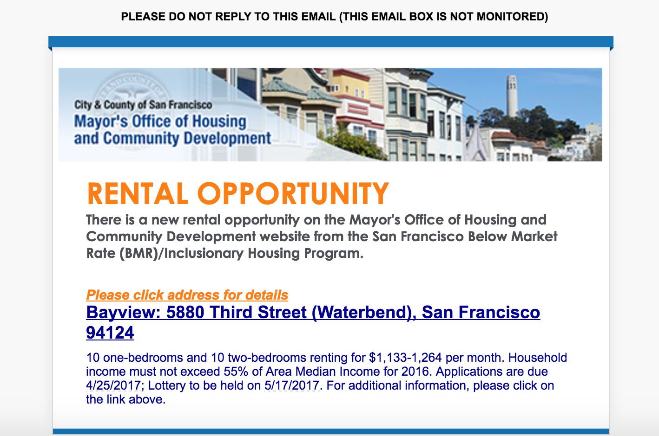
Mail from SF MOHCD: Rental Opportunity

Slide 28
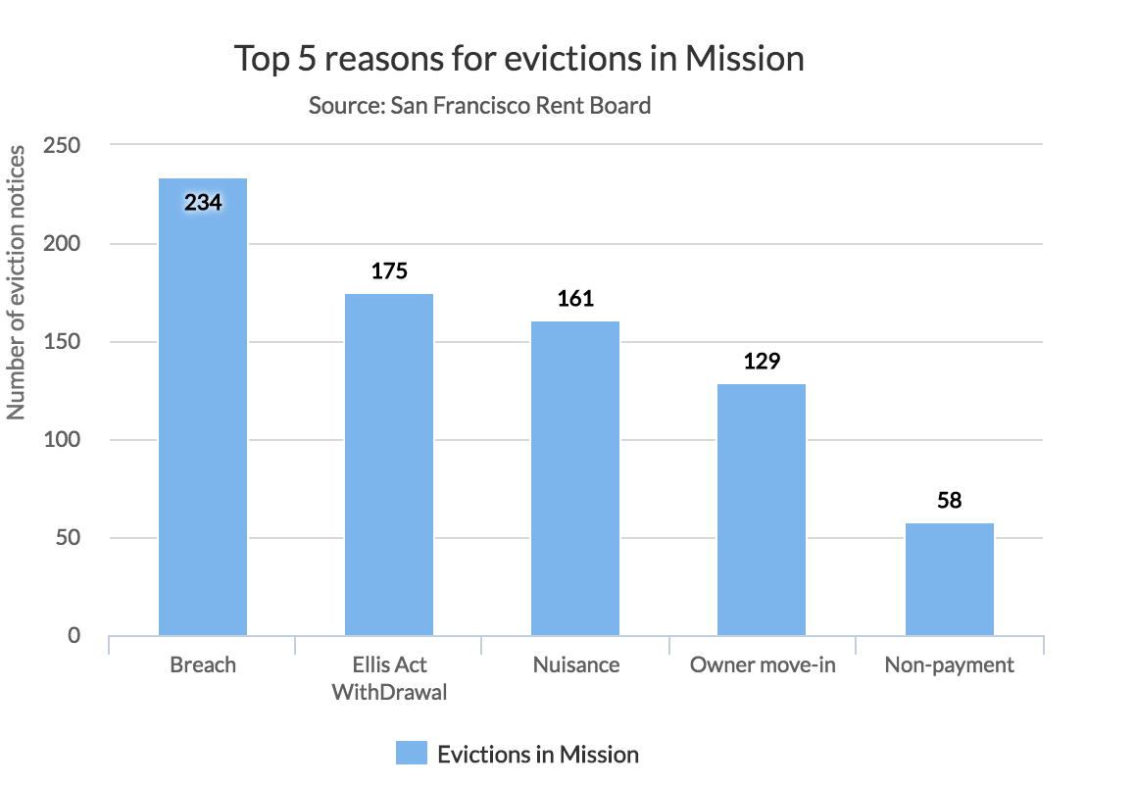
Types of Evictions in Mission 2011-2015
Organizations working to support those displaced:
-EDC: 1338 Mission St., 4th floor
-HRC: 1663 Mission St. #504
-Causa Justa :: Just Cause: 2301 Mission St., 2nd floor
-Catholic Charities (415) 972-1301

Slide 29
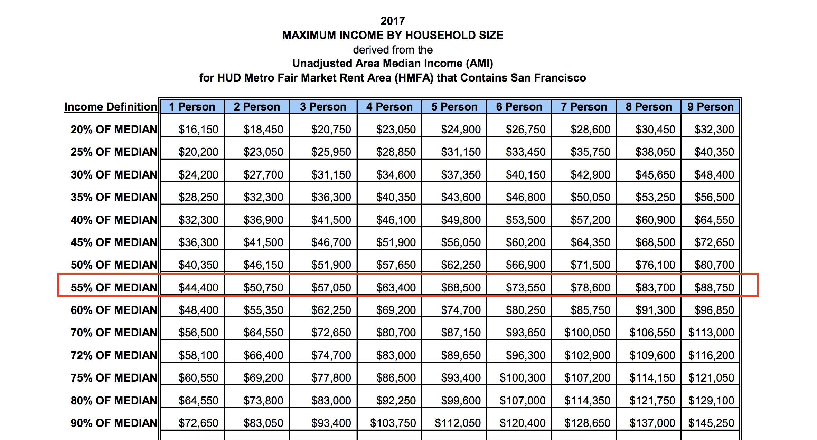
SF AMI 2017

Slide 30
What is 2017 SF AMI chart?
The City of San Francisco created an Area Median Income Chart to measure rent affordability at different income levels.
San Francisco Mayor’s office uses 38% of income towards rent to define what is affordable
Most MOHCD rental opportunities are at 55% of Median Income

Slide 31

MEDA Community Real Estate Program (CRE)
MEDA is expanding and is purchasing buildings to maintain affordable housing in the Mission District !!
MEDA CRE Goals:
Maintaining 400 multi-family buildings
320 apartments of Single Residence Occupancy (SRO) hotels
Producing 300 new apartments and latino retail spaces
Notes:
MEDA’s Community Real Estate (CRE) program was launched in summer 2014 as an urgent response to the displacement happening to low-income and working-class families in the Mission District.
CRE is dedicated to developing multi-family, mixed income units that are affordable and reflective of the Latino community

Slide 32
TO ASSESS OUR FINANCIAL HEALTH,
^{WE LOOK AT FOUR MAIN FACTORS…}
DISC
DEBT INCOME SAVINGS CREDIT
^{DISC}
^{MEDA}
+

Slide 33
DEBT
INCOME
LIFE
GOAL
CREDIT
SAVINGS

Slide 34

^{DEBT}
Debt can be both good and bad
In general it’s best to keep your debts low and pay off your debts as much as you can
Your Debt to Income ratio affects interest rates and your ability to get loans
^{Debit}
^{MEDA}
+

Slide 35

^{INCOME}
Evaluate your income and spending
Brainstorm ways to earn more money; look for a career path
Know your benefits: through employer and public benefits
^{Income}
^{MEDA}
+

Slide 36

^{SAVINGS}
Saving is for everyone, not just the wealthy
Define what you’re saving for, and make a plan to start saving
Evaluate your income and spending and create a budget that includes setting aside savings
^{Savings}
^{MEDA}
+

Slide 37

^{CREDIT}
Your credit report is a detailed report of your past and current debts
Your credit report determines your credit score, is used to decide interest rates, loan qualification, and even job qualification
^{Credit}
^{MEDA}
+

Slide 38
^{HOW TO BUILD CREDIT}
Obtain a financial product
Always pay on time
Keep balances below 30% of your credit limit
Check your credit report for accuracy
^{Credit}
^{MEDA}
+

Slide 39
^{Recommended Financial Products}
Secured Credit Cards.*
Fresh Start Loans (Self Help CU) or Lending Circles (MAF). *
EARN (matched savings program)
ID and proof of address are sufficient to open these accounts. *ITIN or SS may be required for some products
Bank accounts even if you are on ChexSystems or ITIN holder (Credit Union)
Safe Bank Accounts that don’t have overdraft and other fees
^{Credit}
^{MEDA}
+

Slide 40
DEBT
INCOME
Know your debt. Are you ready to to pay or negotiate?
Benefits, taxes, and career pathways
CREDIT
SAVINGS
Build or rebuild credit
Define your short and long-term goals

Slide 41
YOUR JOURNEY FROM HERE TO THERE
Based on what we’ve talked about today, think about your journey.
What are all the things you think need to happen in order for you to achieve your future?
List them out!
5 min
^{Introduction}
^{MEDA}
+
Notes:
Page 3 of “Start Your Journey” handout

Slide 42
^{YOUR COMMITMENT}
Think about what you’re doing today and write down:
1 thing you can start doing (small steps are important!)
1 thing you should stop doing
1 thing you can continue to do
5 min
^{Introduction}
^{MEDA}
+
Notes:
Page 4 of “Start Your Journey” handout

Slide 43
^{3 MINUTE FINANCIAL ASSESSMENT}
Fill out the financial assessment worksheet. (The blue paper)
Be honest with yourself!
We will use this to help you think about your own action plan.
^{Your journey}
‹#›￼
^{MEDA}

Slide 44
Now that we are about to finish, please remember:
Our Philosophy
Financial Capability
Our Programs
Dahlia and MOHCD website as resources for you
^{Credit}
^{MEDA}
+

Slide 45
^{ORIENTATION SURVEY}
Please fill out the orientation surveys found in your folders.
^{Credit}
^{MEDA}
+

Slide 46
THANK
^{YOU}
^{MEDA}
+
Notes:
ADD IN A PREVIOUS SLIDE. If you leave here and remember nothing else… Philosophy MEDA services FinCap

